Slide 1


CODEBASICS RESUME CHALLENGE - 6
PROVIDING INSIGHTS TO THE MARKETING TEAM OF
“CODEX” – A GERMAN BEVERAGE BUSINESS
Presented by:- Pretam Chandra

Slide 2
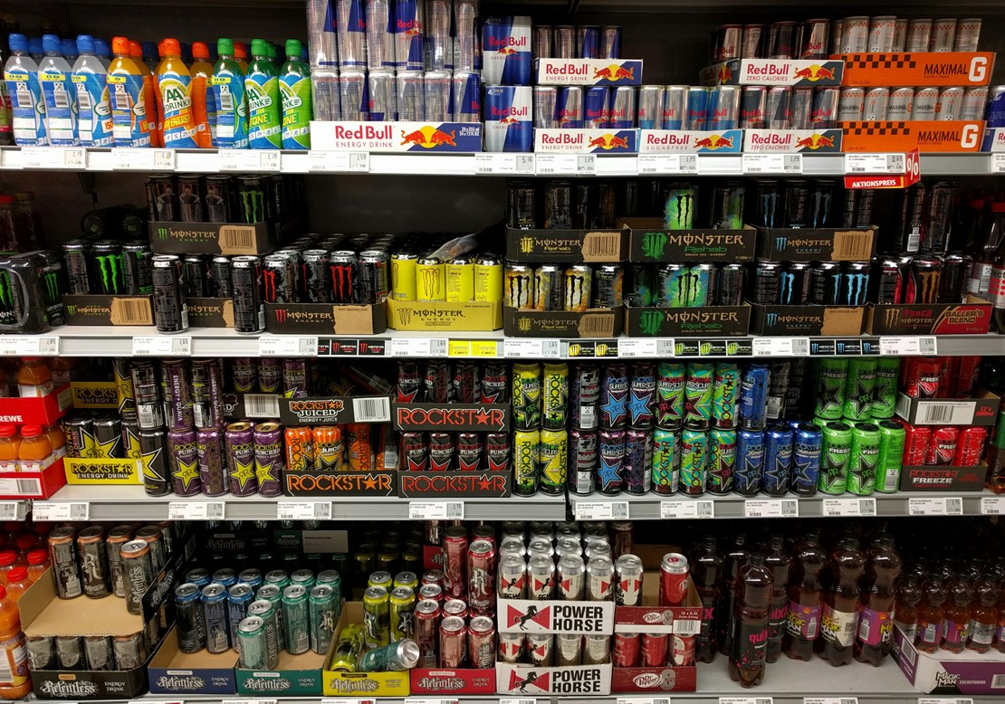
Objectives
Tools Used To Generate Insights
Primary Insights
Secondary insights
Suggestions for CodeX
Data Cleansing Strategies
3
5
CONTENTS
6
7
23
29

Slide 3



TASKS TO BE DONE / objectives
To prepare the dataset for analysis by cleaning it and then processing it.
To acquire insightful information from many categories in order to fully comprehend how the market thinks.
To create clear and compelling visualizations that highlight the most important insights for the Chief Marketing Officer of CodeX to understand.
To provide ideas and advice that will help the organization establish a growth strategy that will be successful.
Please note that it is possible that some respondents might not have answered all the questions sincerely. For instance, a person is more likely to have not tasted the drink if they haven’t heard about it. Sense-check the data and use your judgment to clean it as required.

Slide 4
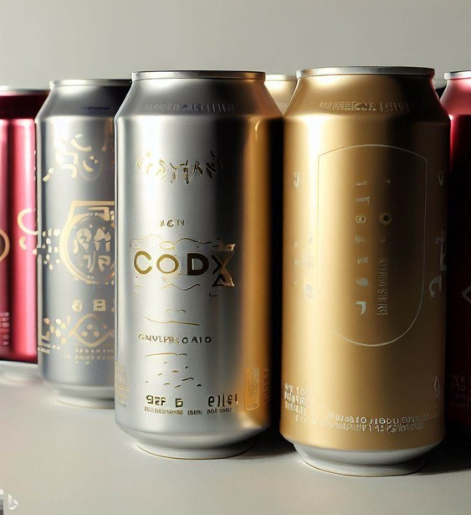
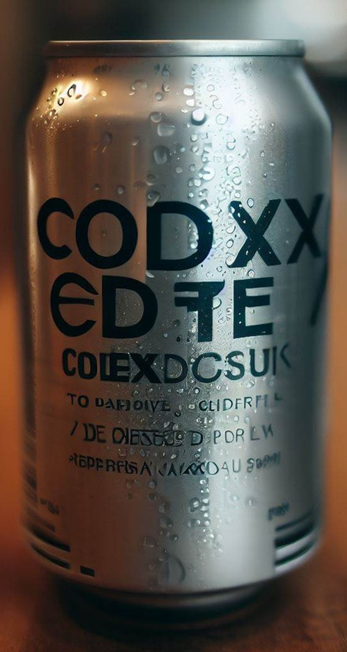
OVERVIEW OF THE COMPANY
German beverage business “CodeX” is attempting to establish itself in the Indian market.
They recently introduced its energy drink in 10 Indian cities.
They conducted a survey in those 10 cities, and 10,000 people responded.

Slide 5
Data Cleansing STRATEGIES
Heard_before: No
Tried_before: No
Brand_perception: Neutral
Heard_before : No
Tried_before : No
Taste_experience: Null

Slide 6


TOOLS USED TO GENERATE INSIGHTs

Slide 7
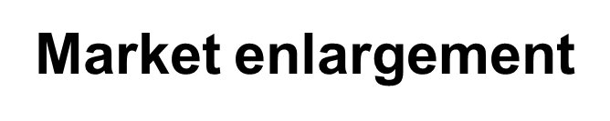
PRIMARY INSIGHTS
Demographic Insights
Consumer Preferences
Competition Analysis
Marketing Channels and Brand Awareness
Brand Penetration
Purchase Behavior
Product Development

Slide 8
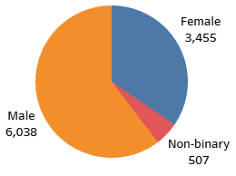
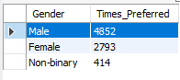
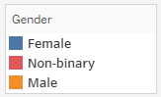
DEMOGRAPHIC INSIGHTS
1.1 Who prefers energy drink more? (male/female/non-binary?)
Conclusions
Clearly, male prefer energy drink more
Around 60% of consumers are MALE followed by Female and Non-Binary

Slide 9
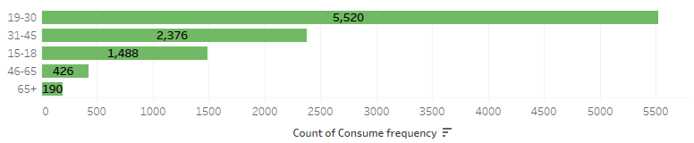
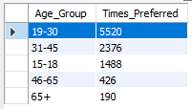
DEMOGRAPHIC INSIGHTS
1.2 Which age group prefers energy drinks more?
Conclusions
Age Group 19-30 prefers energy drinks the most.
This Age Group has nearly 50% consumers among all others.

Slide 10
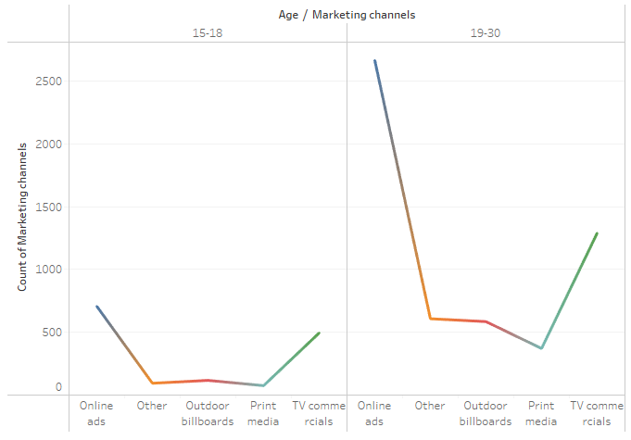
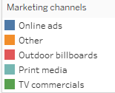
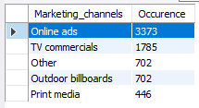
DEMOGRAPHIC INSIGHTS
1.3 Which type of marketing reaches the most Youth (15-30)?
Conclusions
Online ads reaches most to the youths followed by TV commercials for other channels

Slide 11
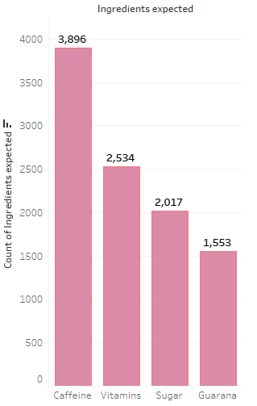
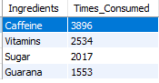
CONSUMERS PREFERENCES
2.1 What are the preferred ingredients of energy drinks among respondents?
Conclusions
Caffeine is the most preferred ingredient in energy drinks which is around 39%
Vitamins, Sugar & Guarana comes next in line

Slide 12
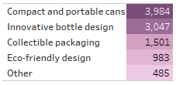
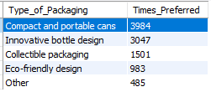
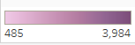
CONSUMERS PREFERENCES
2.2 What packaging preferences do respondents have for energy drinks?
Conclusions
3 9 . 8 % of respondents prefer Compact & Portable Cans as they are light weight & easy to hold
So brands should come up with an innovative bottle that is compact and portable to reach a wider range of consumers.

Slide 13
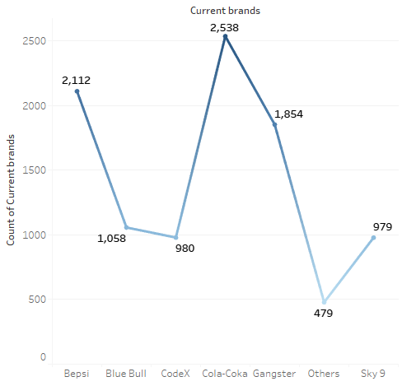
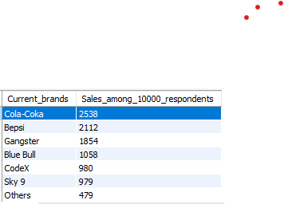
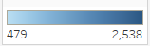
COMPETITIVE ANALYSIS
3.1 Who are the current market leaders?
Conclusions
Cola Coca acquires 1/4th of the energy drinks market followed by Bepsi & Gangster.
Codex comes 5th in the market ranking.

Slide 14
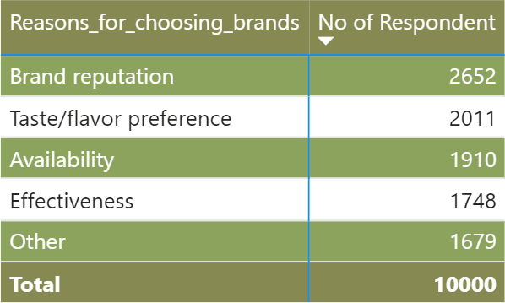
COMPETITIVE ANALYSIS
3.2 What are the primary reasons consumers prefer those brands over ours?
Conclusions
26.5% of the respondents rely on Brand Reputation which is a major factor over preference of other brands.
Other reasons include Taste/flavor preference, Availability etc.

Slide 15
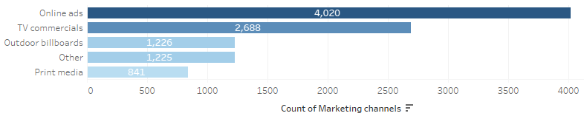
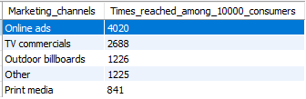
Marketing Channels and Brand Awareness
4.1 Which marketing channel can be used to reach more customers?
Conclusions
Online ads is the most reachable marketing channel across all age groups
It is around 40.2%

Slide 16
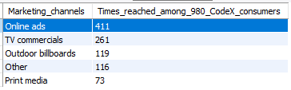
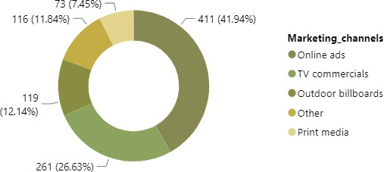
Marketing Channels and Brand Awareness
4.2 How effective are different marketing strategies and channels in reaching our customers?
Conclusions
Almost 42 % of consumers get to know about energy drinks through Online Ads.
CodeX needs to improve its online visibility in order to attract more customers

Slide 17
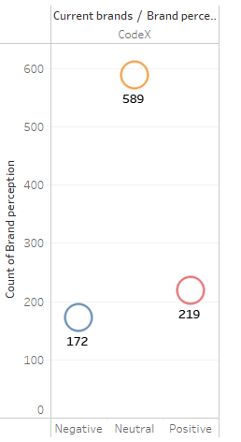
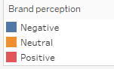
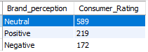
Brand PENETRATION
5.1 What do people think about our brand? (overall rating)
Conclusions
The thinking of respondents about our brand in Neutral
More than 60% rate such

Slide 18
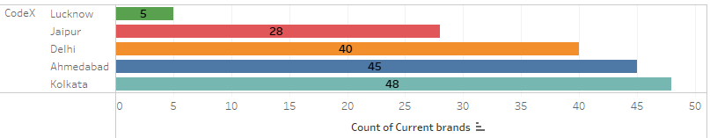
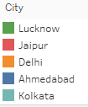
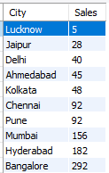
Brand PENETRATION
5.2 Which cities do we need to focus more on?
Conclusions
Theses are the bottom % cities where focus needs to be increased by CodeX.
Among these Lucknow has the least sale.

Slide 19
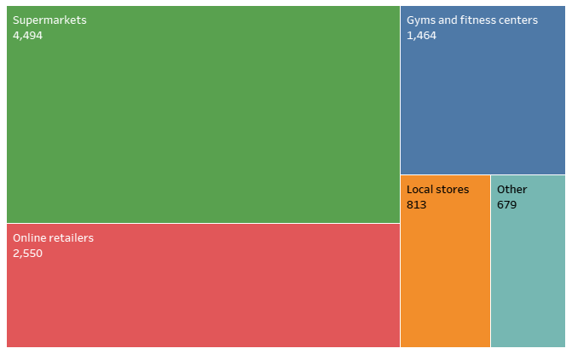
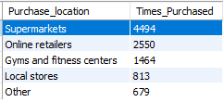
PURCHASE BEHAVIOR
6.1 Where do respondents prefer to purchase energy drinks?
Conclusions
Almost 45% respondents prefer supermarkets.
Supermarkets are the most preferred location to purchase energy drinks.

Slide 20
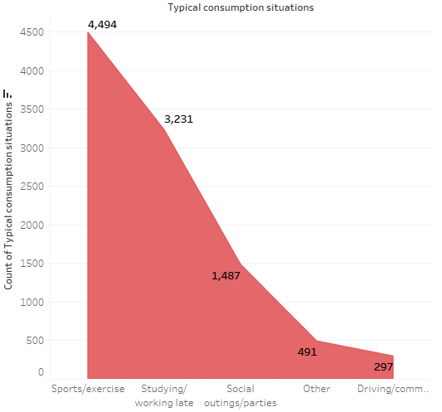
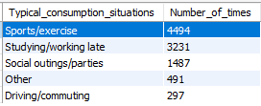
PURCHASE BEHAVIOR
6.2 What are the typical consumption situations for energy drinks among respondents?
Conclusions
Almost 45% respondents prefer supermarkets.
Supermarkets are the most preferred location to purchase energy drinks.

Slide 21
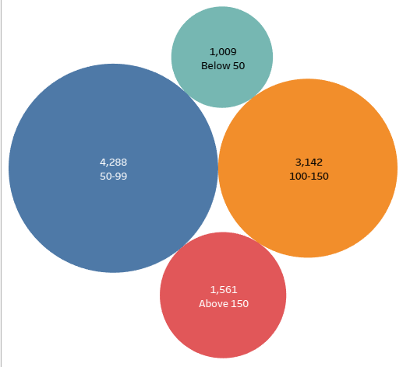
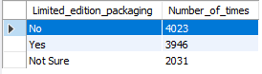
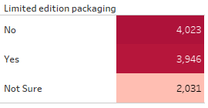
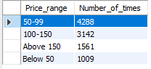
PURCHASE BEHAVIOR
6.3 What factors influence respondents' purchase decisions, such as price range and limited edition packaging?
Conclusions
Around 40 % of consumers say that limited edition packaging influence purchase decisions.
If the price of the energy drink is between 50-99, people tend to purchase more.

Slide 22
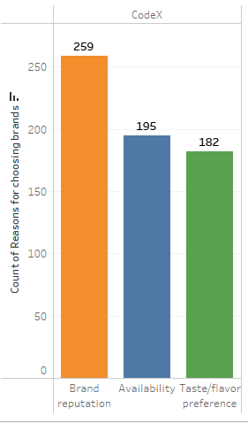
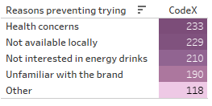
PRoduct dEvelopment
7.1 Which area of business should we focus more on our product development? (Branding/taste/availability)
Conclusions
CodeX should focus more on improving the taste of their drink using healthy materials.
Drinks should have less sugar content such that issues of health concerns get vanished.

Slide 23
1. Immediate changes on the product
2. Optimal price for the drink
3. Marketing campaigns & offers
4. Brand ambassador
5. Market enlargement
Secondary
Insights

Slide 24
People choose CodeX to keep energetic and healthy, thus we should conduct research to increase the amount of caffeine and vitamins.
The brand's flavour experience has an average rating of 3, thus boosting taste is critical.
Ensuring that the product is available to consumers, particularly in supermarkets and online stores.
Enhancing consumers' favourable perceptions of the brand.
1. Immediate changes on the product

Slide 25
2. Optimal price for the drink
Conclusions
This would be accessible to more number of consumers and thus increasing sale.
Optimal price of the drink should be between 50-99

Slide 26
The prices should be controlled so that they don't go over Rs. 150.
Based on the trends, limited edition packages should be offered.
The frequency of purchases might increase if specific collectibles were included.
According to the data, print media is less effective than other types, hence the money spent on it will be put into rewards.
We should encourage customers to post pictures of their collectibles on social media, as this will boost the brand's reputation possibly increase sales.
3. Marketing campaigns
& offers

Slide 27
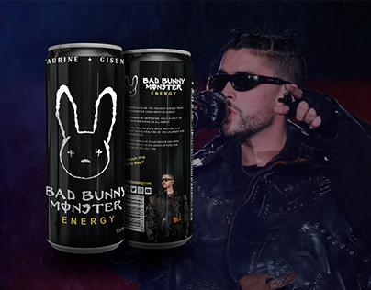
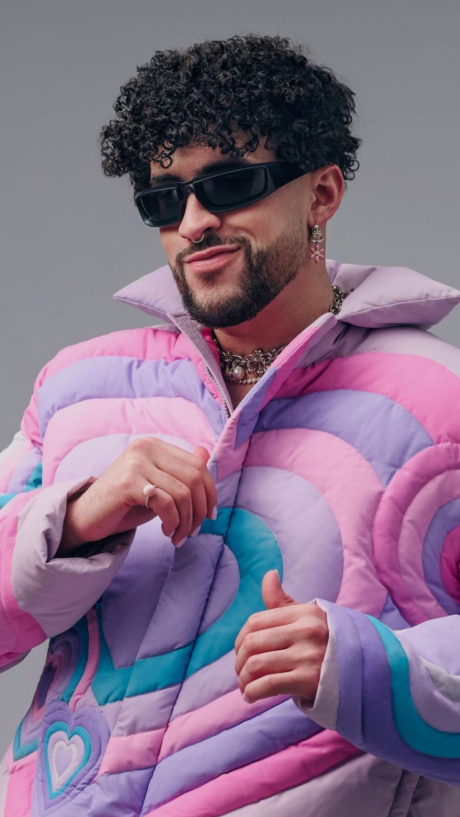
4. Brand ambassador
4. Brand ambassador
He is a global superstar with a massive fan base.
He is associated with energy and excitement, which are two key qualities of energy drinks.
He is very marketable and would help to generate buzz for the energy drink brand.
He is a positive role model who is known for his hard work and dedication.
Bad Bunny is a Puerto Rican rapper and singer who is known for his energetic live performances and his catchy music.
He is also one of the most popular artists in the world, with over 90 million followers on Instagram.

Slide 28
5. Market enlargement
CodeX has reached consumers between the ages of 19 and 45, but we are still behind in reaching those under 19.
In order to appeal to this age group, the marketing strategy, product, and price should all be appropriate.
This will aid the expansion of CodeX in the market.

Slide 29


SUGGESTIONS for codex
Improvements
Add fresh flavours
Ideal Price
Rs 50-99 to acquire market share
Target Audience
Youths visiting cafes
Marketing Campaingns
Simple and lovely packaging
Less use of Sugar
should reflect the mindset of consumers
Better-tasting premium beverages (above 150)
Pay attention to gross sales rather than net profit.
Sporting individuals
Fitness instructors
Nutritionists
Short-term savings
Seasonal offers & Limited Edition Products
Working together with social media content creators
Deals in bundles
Targeted age group:- 15-45
Major consumers:- Sports Person and Fitness Activists.
Preferred Ingredient:- Caffeine
Packaging:- Compact and Innovative Cans. Marketing channel: Online ads and TV commercials.
Brand Ambassador:- Sports Person or Musician with a wide social-media influence.
The product should have fresh flavors with healthy ingredients.

Slide 30


THANK YOU FOR YOUR PATIENCE!!

